Slide 1
SharePoint Data Access Client Side
Access data in SharePoint lists from code running off the SharePoint server
Notes:
Another big investment area in SharePoint 2010 by Microsoft is the introduction of the client object model. This object model extends to .NET, Silverlight and ECMAScript enabling developers an easier way to work with SharePoint than the included Web services. In this module you will learn how to leverage each of these three client object models as well as how to utilize ASP.NET AJAX in SharePoint projects In addition you will also learn how to use the new WCF Data Services (OData/REST) and Web Services to access SharePoint data from off the server.

Slide 2
Agenda
Introduction to SharePoint Client Object Model
Using the Client Object Model with .NET
Using the Client Object Model with Silverlight
Using the Client Object Model with ECMAScript
WCF Data Services / OData / REST

Slide 3
Why Client Object Model?
More SharePoint Web services is a major request
Client Object Model provides complete API instead of more services
Provides an abstraction layer to return results as recognizable SharePoint objects
Consistent developer experience across platforms (.NET, Silverlight, ECMAScript)
Notes:
Throughout each SharePoint release, Microsoft receives more and more requests for new Web Services.
Instead of continuously building new Web services (and replacing existing ASMX services with WCF services), they now provide a client object model.
The client object model provides an abstraction layer so processes off the SharePoint server can interact with SharePoint using a consistent API that is very closely matched to the familiar server API.

Slide 4
Supported Areas
Site Collections and Sites
Lists, List Items, Views, and List Schemas
Files and Folders
Web, List, and List Item Property Bags
Web Parts
Security
Content Types
Site Templates and Site Collection Operations
Notes:
The Client Object Model contains a lot of overlap coverage with the full SharePoint API. A lot activities that are possible through the SharePoint API, are also possible through the different client object models.

Slide 5
Equivalent Objects
Server (Microsoft .SharePoint) | .NET Managed (Microsoft.SharePoint .Client) | Silverlight (Microsoft.SharePoint .Client.Silverlight) | ECMAScript (SP.js)
SPContext | ClientContext | ClientContext | ClientContext
SPSite | Site | Site | Site
SPWeb | Web | Web | Web
SPList | List | List | List
SPListItem | ListItem | ListItem | ListItem
SPField | Field | Field | Field
Member names mostly the same from server to client (e. g., SPWeb.QuickLaunchEnabled = Web.QuickLaunchEnabled)
Notes:
Similar to programming against server objects in the server context, the new client-side object models use a ClientContext object as the "center of gravity" for all operations. The process of obtaining and working with sites and data begins by retrieving a context object.
Locations of the different data access resources:
Server – Microsoft.SharePoint – [..]\14\ISAPI
.NET – Microsoft.SharePoint.Client – [..]\14\ISAPI
Silverlight – Microsoft.SharePoint.Client.Silverlight – [..]\14\LAYOUTS\ClientBin
ECMAScript– SP.js - [..]\LAYOUTS

Slide 6
Using the Client Object Model
ECMAScriptControls and Logic
Browser
Client.svc
Server OM
JSON Response
ECMAScript OM
XML Request
Proxy
XML Request
Proxy
Content database
JSON Response
Managed OM
Managed Client
Managed Controls and Logic
SharePoint Server
Notes:
This diagram displays how the transport mechanism works.
Managed ClientOM= .NET / Silverlight.
All communication goes through the client.svc WCF service.
Microsoft implemented the ClientOM by decorating the core SharePoint OM with attributes if it was “client aware”:
[ClientCallableType(Name=“Web”,[…]),[…]]
public class SPWeb {}
Then a code generation tool generates the ClientOM assemblies and JavaScript.
This ensures that there’s fidelity between all the ClientOM’s and the server equivalent.

Slide 7
ClientContext – Connecting to SharePoint
All ClientOM’s are centered on the ClientContext
Handles the link and all communication with the SharePoint site
Managed ClientOM’s accept a URL in the constructor
ECMAScript ClientOM is bound to the current site
Sending commands to SharePoint:
ExecuteQuery() - .NET ClientOM – syncronous
ExecuteQueryAsync(successCallback, failCallback) – Silverlight & ECMAScript ClientOM - asynchronous
Notes:
The ClientContext is the entry point for communication with the SharePoint site. The .NET ClientOM and the Silverlight OM can accept a URL in the constructor when the ClientContext is initialized. The ECMAScript ClientOM is always bound to the current SharePoint site.
Commands are sent to SharePoint using the ExecuteQuery method. For the .NET ClientOM this call executes synchronously. In Silverlight and ECMAScript you need to use the ExecuteQueryAsync method, which executes asynchronously. Therefore you also need to pass a callback method to which the result from the server returns when the call executes successfully, and a callback method to which the server returns in case of a fail.

Slide 8
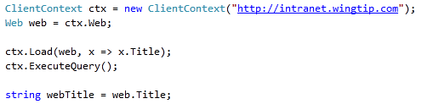
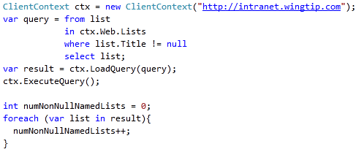
Retrieving Data & Executing Code
ClientContext.Load(object, params LinqExpression)
In-Place load: Returns data by updating the object itself
ClientContext.LoadQuery(IQueryable)
Queryable load: Returns data in another array
Both are queued until ExecuteQuery[Async]() called
Notes:
Before you execute the ExecuteQuery method, you need to indicate which data you want to retrieve from the server. You can use the ClientContext.Load method for this purpose.
There are a number of overloads for this method:
ClientContext.Load(object): this can be a list for example. When executing the ExecuteQuery method, the complete list will be returned to the client.
ClientContext.Load(object, linqExpression): this will return a limited set of data to the client when executing the ExecuteQuery method.
You can execute one or more calls to the Load method before executing the ExecuteQuery method. This will retrieve and return all requested data at once.
Another variant is the LoadQuery method. This stores the resulting data in another collection or array.

Slide 9
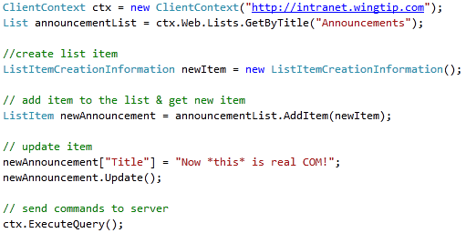
Creating Objects
Creation of objects (those that can be created) is handled using creation objects:
ListCreationInformation()
ListItemCreationInformation()
WebCreationInformation()
NavigationNodeCreationInformation()
…
Notes:
You cannot only retrieve data using the ClientOM, but you can also create objects using specific classes.
ListCreationInformation: use this class to create a new list. You can set properties like Title and TemplateType before calling the web.Lists.Add method, passing the ListCreationInformation object as argument.
ListItemCreationInformation: use this class to create a new list item on an existing list. The AddItem method on the List object accepts the ListItemCreationInformation argument and returns the new list item of type ListItem. You can fill out the list item using the listItem["Title"] syntax for the different columns on the list, and calling the Update() method on the list item.
WebCreationInformation: if you want to create a new SharePoint site, instantiate an object of this type and pass it to the Webs.Add method of a Web object.
NavigationNodeCreationInformation: use this class to create a new navigation node.

Slide 10
Client Object Model & Authentication
Silverlight & ECMAScript ClientOM limited to browser context
.NET ClientOM - Windows or Forms Auth
Set authentication mode:
clientCtx.AuthenticationMode =
ClientAuthenticationMode.FormsAuthentication;
Specify user authentication details:
FormAuthenticationLoginInfo loginInfo = new FormAuthenticationLoginInfo(“User”,”password”);
clientCtx.FormsAuthenticationLoginInfo = loginInfo;
Notes:
By default, the managed client object models authenticate users by using their Windows credentials (DefaultCredentials). Optionally, you can change the authentication mode on the ClientContext object and specify using Forms authentication instead. A user must then supply a user name and password through properties on ClientContext. Behind the scenes, SharePoint Foundation calls the Authentication Web service, obtains the correct cookie, and then makes the necessary object model calls. To run managed client code against a Forms authentication server, you must change to Forms authentication. This requirement does not apply to the JavaScript object model.
The managed client object models provide a ClientAuthenticationMode enumeration whose values are Anonymous, Default, and FormsAuthentication. To specify Forms authentication, use code similar to the following:
clientContext.AuthenticationMode = ClientAuthenticationMode.FormsAuthentication;
In addition to setting the authentication mode, you must specify the user name and password information, such as follows:
FormsAuthenticationLoginInfoformsAuthInfo = new FormsAuthenticationLoginInfo("MyUser", "MyPassword");
clientContext.FormsAuthenticationLoginInfo = formsAuthInfo;
Note: The account name and password in formsAuthInfo are sent in clear text, so you must use HTTPS protocol instead of HTTP.

Slide 11
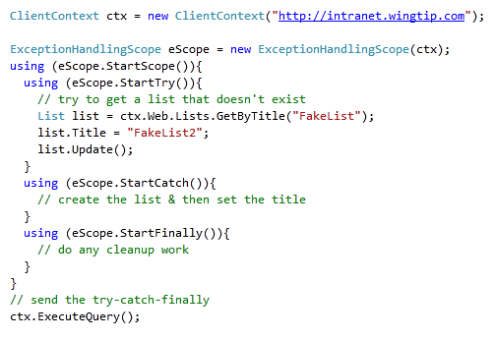
Remote Error Handling
All three ClientOM’s can send exception handling code to the server for batch processing
Reduces chatty & time consuming round-trips to server
Notes:
After creating the ClientContext, you can create a ExceptionHandlingScope. You can wrap up all your code that communicates with the client object model within a using(eScope.StartScope()){...} to avoid that exceptions go back and forth over the wire. All exceptions are queued and can be checked in the using (StartCatch()){...} part of your code.

Slide 12
Agenda
Introduction to SharePoint Client Object Model
Using the Client Object Model with .NET
Using the Client Object Model with Silverlight
Using the Client Object Model with ECMAScript
WCF Data Services / OData / REST

Slide 13
Implementing .NET Client Object Model
Using the .NET ClientOM requires adding two references
Microsoft.SharePoint.Client.dll
Microsoft.SharePoint.Client.Runtime.dll
Both are found in [..]\14\ISAPI
Microsoft.SharePoint.Client.dll
Includes the .NET ClientOM API’s
Microsoft.SharePoint.Client.Runtime.dll
Handles all the communication, serialization & deserialization between the client application & SharePoint server
Notes:
If you want to develop agains the .NET client object model, you have to add two references to assemlies in the 14\ISAPI folder:
Microsoft.SharePoint.Client.dll: this assembly contains the .NET ClientOM API
Microsoft.SharePoint.Client.Runtime.dll: handles all the communication, serialization and deserialization between the client application and the SharePoint server.

Slide 14
DEMO
.NET Client Object Model

Slide 15
Agenda
Introduction to SharePoint Client Object Model
Using the Client Object Model with .NET
Using the Client Object Model with Silverlight
Using the Client Object Model with ECMAScript
WCF Data Services / OData / REST

Slide 16
Silverlight Client Object Model
Silverlight Development Enabled by ClientOM
Can use Silverlight in separate ASPX page or in Web Part
Can utilize ClientOM in Silverlight to create SharePoint apps
Notes:
There is also a client object model for Silverlight. A Silverlight application can be hosted in a ASPX page but also in Web Parts. When communication is needed with the SharePoint server from within the Silverlight application, a ClientContext first need to be initialized. When the Silverlight application is hosted on a separate ASPX page, the ClientContext instance needs to be initialized using the URL of the SharePoint site. If the Silverlight application is hosted within a SharePoint web part or from within other SharePoint artifact, like a custom field f.e, the ClientContext can be instantiated using ClientContext.Current.

Slide 17
Silverlight Development Primer
Development Tools:
Visual Studio 2010
Used to do the managed code development (XAML code behind)
Expression Blend
Used to design the user interface
Both tools used hand-in-hand on same project
Silverlight always communicates with server asynchronously
Can’t interact with UI on same data access thread
Notes:
Simple Silvelright applications can be developed with the Visual Studio tools for Silverlight. If you need more complex user interfaces, you can design the user interface (the XAML) with Expression Blend. The project created in Expression Blend can easily be opened in Visual Studio Tools for the further development of the managed code.
Silverlight always communicates with the server in an asynchronous way and on a different thread. When the server returns a result to the Silverlight application, the application needs to do the necessary work to expose the result to the UI thread. You can achieve this by using the Dispatcher and its BeginInvoke method.

Slide 18
Creating Silverlight Web Parts
Web Part can be a host for Silverlight apps
Two Silverlight Web Part Options
SharePoint ships with Silverlight Web Part
Only accepts URL of *.XAP as single parameter
Custom Web Parts can contain custom properties that are sent to Silverlight via the InitParameters property
Silverlight deployment options:
_layouts
Document library
Notes:
A SharePoint Web Part can easily host a Silverlight application. SharePoint 2010 has an out of the box Silverlight Web Part that can be used to host your Silverlight application. You only have to specify the URL to the *.xap file to make the Web Part render the Silverlight application.
You can also develop your own custom Web Part that hosts the Silverlight application. Additionally you can expose custom properties on your web part and pass the values to the Silverlight application through the InitParams attribute.
You can deploy the Silverlight application to different locations like the _layouts folder, a document library or the bin folder of the web application.

Slide 19
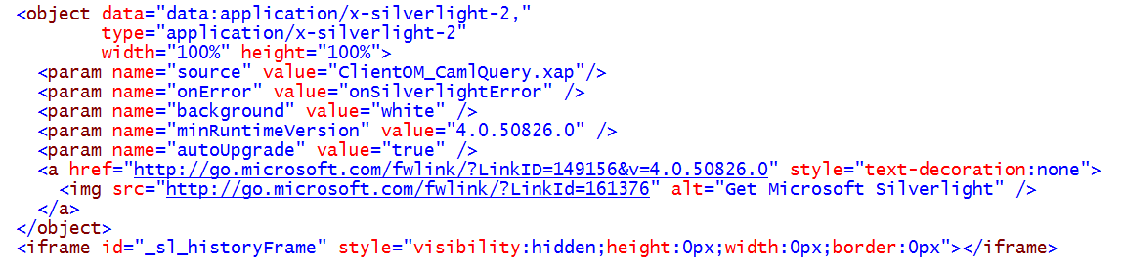
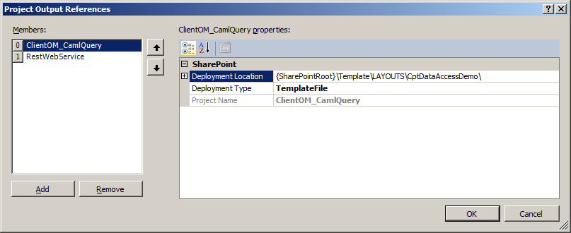
Hosting A Silverlight Application
Many ways to host in SharePoint Development
Application page, site page, Web Part
Add object tag to HTML
Add Project Output Reference to SharePoint Project Item
Notes:
Once you’ve built a Silverlight application it must be somehow launched. This is done by adding the Silverlight runtime control to a page and referencing the Silverlight *.XAP file.
Silverlight projects are constructed in one type of project in Visual Studio 2010, they can not be created in a SharePoint project. To include the Silverlight *.XAP file in the SharePoint project for inclusion in a *.WSP for provisioning, add a SharePoint Project Item to the SharePoint project using the Module template. From the Properties tool pane, add the project output of the Silverlight file to the SharePoint project as either a TemplateFile or ElementFile.

Slide 20
Implementing Silverlight Client Object Model
Using the .NET ClientOM requires adding two references
Microsoft.SharePoint.Client.Silverlight.dll
Microsoft.SharePoint.Client.Silverlight.Runtime.dll
Both are found in [..]\14\TEMPLATES\LAYOUTS\ClientBin
Microsoft.SharePoint.Client.Silverlight.dll
Includes the .NET ClientOM API’s
Microsoft.SharePoint.Client.Silverlight.Runtime.dll
Handles all the communication, serialization & deserialization between the client application & SharePoint server
Notes:
For Silverlight client installations, Microsoft SharePoint Foundation deploys two assemblies:
Microsoft.SharePoint.Client.Silverlight.dll: this assembly contains the .NET ClientOM API.
Microsoft.SharePoint.Client.Silverlight.Runtime.dll: handles all the communication, serialization and deserialization between the client application and the SharePoint server.
These assemblies are available into a special "Scripts only" folder of the /_layouts virtual directory named clientbin. This folder is designed to be a standard place for hosting assemblies that are used in Silverlight.

Slide 21
DEMO
Silverlight Client Object Model & Web Part

Slide 22
Agenda
Introduction to SharePoint Client Object Model
Using the Client Object Model with .NET
Using the Client Object Model with Silverlight
Using the Client Object Model with ECMAScript
WCF Data Services / OData / REST

Slide 23
ECMAScript Client Object Model
ECMAScript ClientOM provides a way to interact with SharePoint from the rendered page in the browser
Differences between managed & ECMAScript ClientOM:
Method signatures can be different
Different data value types
Managed ClientOM’s can talk to any SharePoint site
ECMAScript ClientOM can only interact with originating site (due to cross-site scripting controls)
Implemented a single JavaScript library:
/_layouts/sp.js
All JavaScript libraries crunched for performance
Use un-crunched *.debug.js by adding
<SharePoint:ScriptLink … ScriptMode=“Debug” />
Can also set <Compilation … debug=“” /> in web.config for Web app scoped affect
Notes:
You should be aware of the following important differences between the ECMAScript and managed client object models:
The method signature may be different, as with the ClientContext constructor.
The two object models use different data value types. The ECMAScript object model does not have equivalents for all the data value types in the .NET Framework managed object model.
ECMAScript regards StringCollection as string[]. On the other hand, ECMAScript has some values that the .NET Framework does not have, such as NaN, or negative and positive infinity.
The ECMAScript object model requires that you include security validation on the page through a FormDigest control:
<SharePoint:FormDigest id="MyFormDigest" runat="server"/>.
Compressed and crunched *.js files for the ECMAScriptobject model, named SP.js, SP.Core.js, and SP.Runtime.js, are installed in the /_layouts directory. Microsoft SharePoint Foundation also includes uncrunched, debug versions of the *.js files named SP.debug.js, SP.Core.debug.js, and SP.Runtime.debug.js. You can toggle which *.js file is used in Microsoft SharePoint Foundation by setting ScriptMode="Debug" in web.config. If you add <SharePoint:ScriptLinkrunat=”server” Name=”sp.js” Localizable=”false” LoadAfterUI=”true” /> to the page, the Microsoft.SharePoint.WebControls.ScriptLink server control registers all dependencies.

Slide 24
Implementing ECMAScript Client Object Model
Need to add a reference in ASPX page to the JavaScript library:
<SharePoint:ScriptLink runat="server" Name="sp.js" LoadAfterUI="true" Localizable="false" />
If your client-side code modifies a SharePoint site / list, you need to add a FormDigest control to the ASPX page:
<SharePoint:FormDigest runat=“server” />
Notes:
If you want to work with the ECMAScript Client Object Model, you have to add a ScriptLink control to the .aspx page and point it to the sp.js file. To be able to add a ScriptLink control to the page you have to include the registration of the Microsoft.SharePoint.WebControlsnamespace by adding a directive to the .aspx page.
If your code modifies a Web site or a list, include a FormDigest control to create a digest for security validation of the page.

Slide 25
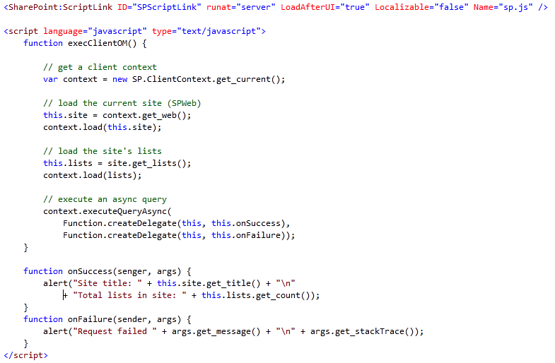
ECMAScript ClientOM
Notes:
This code sample creates a ClientContext instance by using the current SharePoint context. With the ECMAScript Client Object Model you have the choice to execute queries synchronously using the executeQuery method, or execute queries asynchronously using the executeQueryAsync method. When using the executeQueryAsync method you also have to pass callback methods, one for successful completion and one in case of failure.
With the ECMAScript Client Object Model you can also create lists and list items by using the ListCreationInformation class and ListItemCreationInformation class.

Slide 26
DEMO
ECMAScript Client Object Model

Slide 27
Agenda
Introduction to SharePoint Client Object Model
Using the Client Object Model with .NET
Using the Client Object Model with Silverlight
Using the Client Object Model with ECMAScript
WCF Data Services / OData / REST

Slide 28

REST-based Queries with ListData.svc
Built-in SharePoint Web service
REST-based
Queries and results based on OData
Notes:
SharePoint 2010 introduces support for RESTful queries on SharePoint list data. This is done using the ListData.svc service. This service is a WCF Data Service, Microsoft’s implementation of the open data protocol (aka: OData) that was developed by multiple companies. The OData protocol is founded on RESTful principles so developers with experiencing using RESTful services should be right at home using the ListData.svc service.
While ListData.svc is installed with the RTM release of SharePoint 2010, it does not automatically work. This is because WCF Data Services is not included in the .NET Framework 3.5 SP1, a prerequisite of SharePoint 2010. It is provided as an extra install to the .NET Framework. Make sure you get the correct version for where you are hosting SharePoint 2010 (server / client development environment) as there are different installs for each. The path is only required where SharePoint 2010 is running and can be acquired from MSDN:
http://msdn.microsoft.com/en-us/data/ee720179

Slide 29
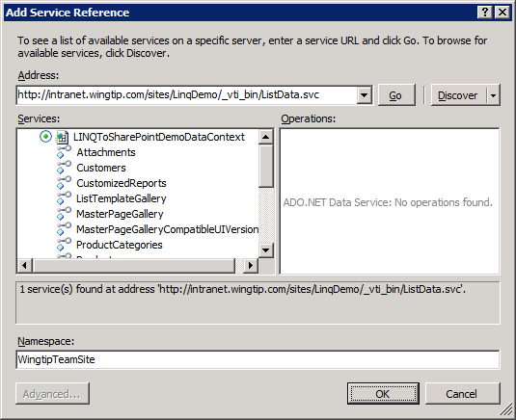
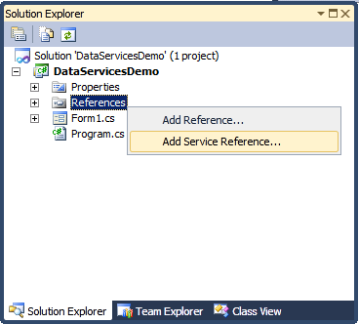
Creating the Client-side Proxy Class
Done by adding WCF Service Reference
Adding WCF reference generates proxy class
Proxy class provides LINQ-based access
Proxy class contains DataContext object
Notes:
You can create the client-side proxy class by adding a WCF Service Reference to your Visual Studio project. The URL you need to provide is a concatination of the SharePoint site you want to query, and the location of the ListData.svc service. This ListData.svc service is located in the virtual _vti_bin directory, just as the out of the box SharePoint web services.
The proxy class contains a DataContext object that is the access point to your SharePoint site. You can use LINQ queries to retrieve data from the SharePoint lists.

Slide 30
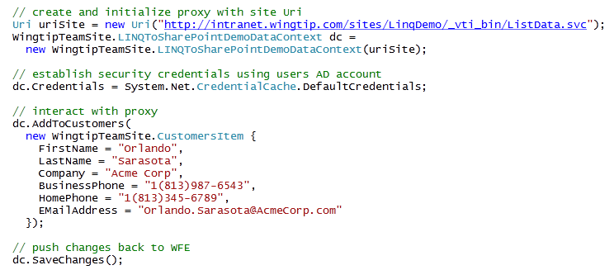
Connecting through the DataContext
DataContext provides connection to site
Initialized with Uri which points to target site
Usually requires establishing security credentials
Provides methods for querying and modify list items
Notes:
The proxy class contains a DataContext object that is the access point to your SharePoint site. You can use LINQ queries to retrieve data from the SharePoint lists.
When instantiating the DataContext, you have to provide the URL to the SharePoint site you want to query. You can use the default credentials, but you can also specify specific credentials to access the SharePoint site. You can interact with the proxy using LINQ to retrieve and update SharePoint list data.

Slide 31
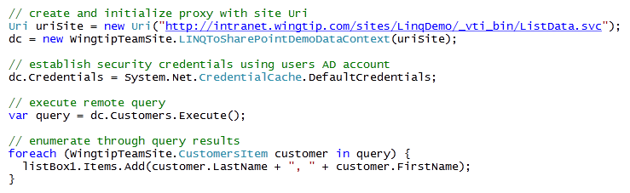
LINQ Queries Using WCF Data Services
Proxy exposes lists as entity classes
Collections implemented as IEnumerable<T>
Can leverage LINQ to Objects in queries
Possible query with filtering and ordering

Slide 32
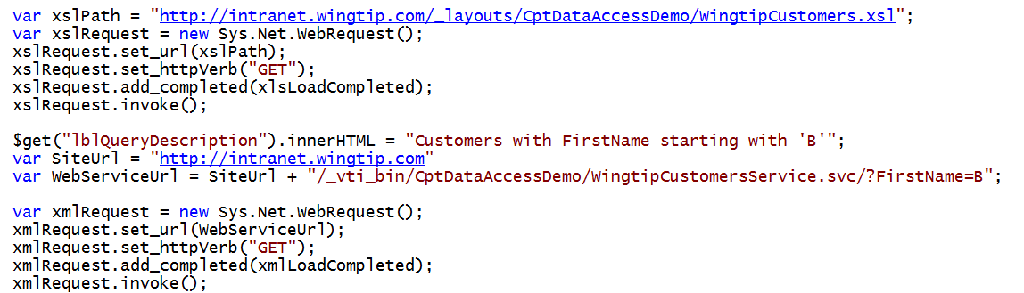
Web Service Access from JavaScript
ListData.svc is not just accessible via managed code
Can also be called using JavaScript & transform the XML results using XSLT

Slide 33
DEMO
Writing WCF Data Services Queries that Execute Against Remote SharePoint Lists

Slide 34
Summary
Introduction to SharePoint Client Object Model
Using the Client Object Model with .NET
Using the Client Object Model with Silverlight
Using the Client Object Model with ECMAScript
WCF Data Services / OData / REST

